Slide 1
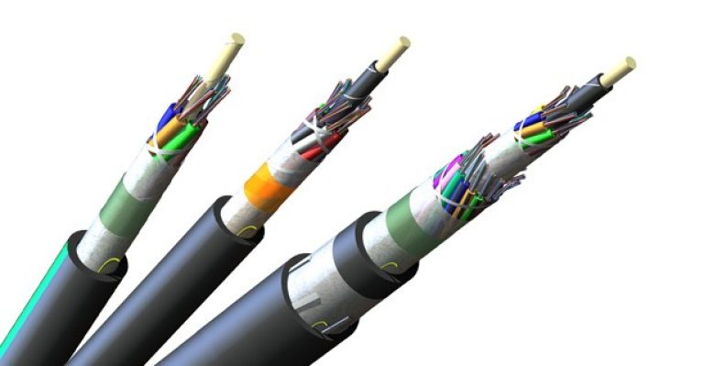

For the Degree of Bachelors of Electronics & Telecommunication
Topic:-Performance Analysis of Optical Communication System using APD and PIN Photodiodes with OptiSystem Simulation
Amey Pilankar
Roll No. 61
Aryan Rajpure
Roll No. 62
Pawan Sahu
Roll No. 63
Charul Sawant
Roll No. 64
Guided by :
Dr. Baban U. Rindhe
(HOD of EXTC )
Department of Electronics & Telecommunication Engineering
K. C. College of Engineering & Management Studies & Research, Thane (E)

Slide 2

OUTLINE OF PRESENTATION
• Introduction • Objective • System Overview • APD Photodiode • PIN Photodiode • Real-life Application • Conclusion & Future Scope • References
Performance Analysis of Optical Communication System using APD & PIN Photodiodes

Slide 3


INTRODUCTION
Optical communication is a technology that uses light signals transmitted through fiber optic cables for efficient data communication
It offers very high speed, large bandwidth, and low signal attenuation, making it superior to conventional communication systems
Optical communication forms the backbone of modern systems such as internet, telecommunications, data centers, and digital networks
It enables reliable long-distance communication with minimal signal loss and high data security
Project Focus:
Design and simulation of an optical communication system using OptiSystem software
Comparative analysis of APD (Avalanche Photodiode) and PIN Photodiode based on performance parameters
Evaluation of system performance using Bit Error Rate (BER)
Performance Analysis of Optical Communication System using APD & PIN Photodiodes

Slide 4

OBJECTIVE
To design and simulate an efficient optical communication system using OptiSystem software
To perform a comparative analysis of Avalanche Photodiode (APD) and PIN Photodiode under identical operating conditions
To evaluate system performance using Bit Error Rate (BER) and signal quality parameters
To study the impact of different photodetectors on signal detection and system efficiency
To understand the practical implementation of optical communication in real-life applications such as telecom, metro systems, and data networks
Performance Analysis of Optical Communication System using APD & PIN Photodiodes

Slide 5
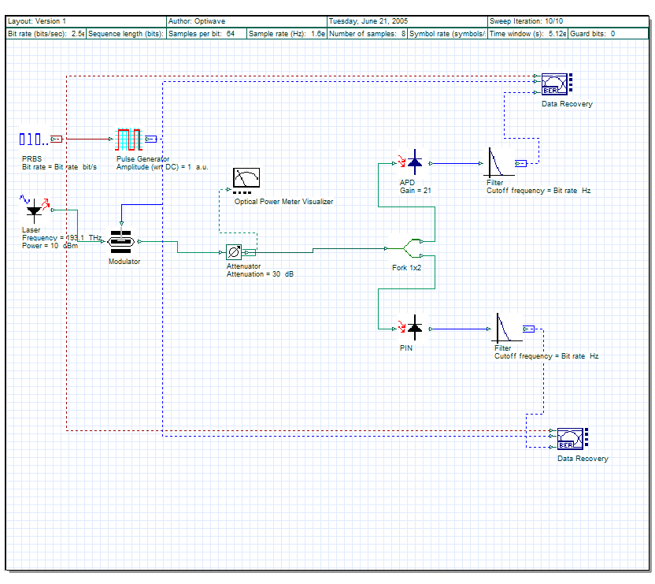
SYSTEM OVERVIEW
Block Explanation:
PRBS Generator → Generates random binary data
Pulse Generator → Converts data into electrical signal
Laser Source → Generates optical signal
Modulator → Converts electrical to optical signal
Attenuator → Simulates signal loss
Fork → Splits signal to APD and PIN
Performance Analysis of Optical Communication System using APD & PIN Photodiodes

Slide 6
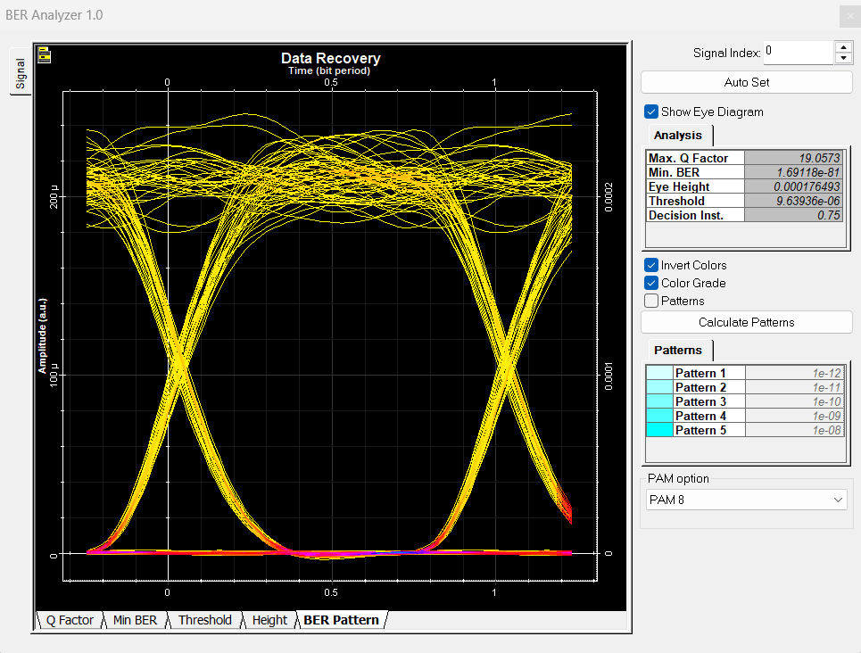
APD PHOTODIODE
APD (Avalanche Photodiode):
Has internal gain (≈21)
Works on avalanche multiplication
High sensitivity
Advantages:
Detects weak signals
Suitable for long distance communication
Disadvantages:
High noise
Expensive
Performance Analysis of Optical Communication System using APD & PIN Photodiodes

Slide 7
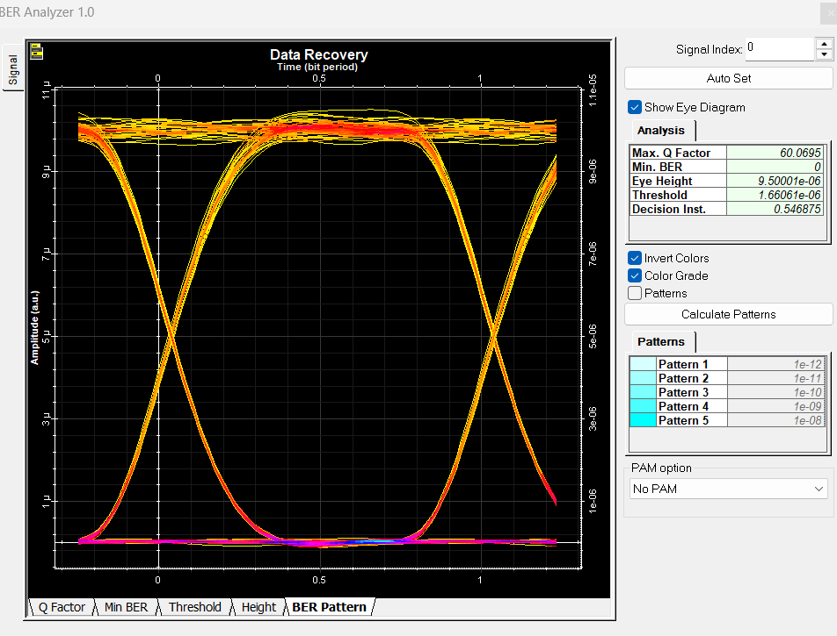
PIN PHOTODIODE
PIN Photodiode:
Consists of P-I-N structure
No internal gain
Direct conversion of optical to electrical signal
Advantages:
Low noise
Low cost
Stable performance
Disadvantages:
Less sensitive
Cannot detect very weak signals
Performance Analysis of Optical Communication System using APD & PIN Photodiodes

Slide 8
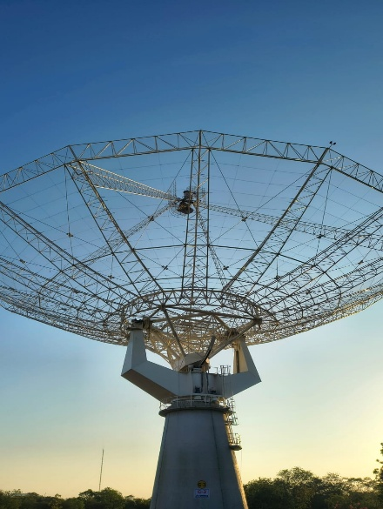

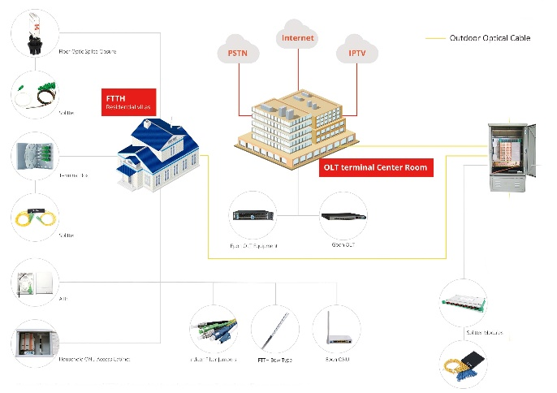
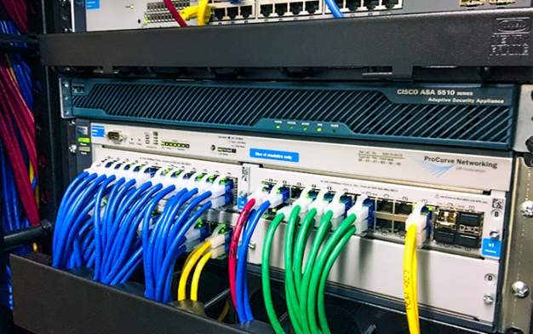
REAL LIFE APPLICATION
APD Used In:
Long distance fiber communication
Metro rail signaling
Satellite communication
PIN Used In:
Broadband internet
LAN networks
Cable TV systems
Performance Analysis of Optical Communication System using APD & PIN Photodiodes

Slide 9
CONCLUSION & FUTURE SCOPE
Conclusion:
APD photodiode provides higher sensitivity and better signal detection, resulting in lower Bit Error Rate (BER)
PIN photodiode offers stable performance with low noise and low cost, making it suitable for economical systems
The overall performance of the optical communication system depends on the type of photodetector used and system requirements
APD is preferred for long-distance and high-performance communication, while PIN is suitable for short-distance and cost-effective applications
Future Scope:
Implementation in 5G and upcoming 6G optical communication networks
Use in smart city infrastructure and intelligent transport systems
Development of high-speed and high-capacity optical networks
Integration with AI-based signal processing for better performance
Improvement in low-noise and high-efficiency photodetectors
Performance Analysis of Optical Communication System using APD & PIN Photodiodes

Slide 10
REFERENCES
[1] G. Keiser, Optical Fiber Communications, 5th ed., New York: McGraw-Hill, 2013.
[2] J. M. Senior, Optical Fiber Communications: Principles and Practice, 3rd ed., Pearson Education, 2009.
[3] G. P. Agrawal, Fiber-Optic Communication Systems, 4th ed., Wiley, 2010.
[4] Optiwave Systems Inc., OptiSystem User Reference Manual, Available: www.optiwave.com
[5] “Photodiode – PIN and Avalanche Photodiode,” Electronics Hub, Available: www.electronicshub.org
[6] “Optical Communication System Basics,” TutorialsPoint, Available: www.tutorialspoint.com
Performance Analysis of Optical Communication System using APD & PIN Photodiodes

